Slide 1
DS8015 - Machine Learning non-DS Stud
W2022
Prof. Roy Kucukates
E: roy.kucukates@ryerson.ca

Slide 2
Agenda
Description of the problem
Data sources with information (Datasets)
Description of the models and techniques utilized
K-Means Clustering Models and Frequency Analysis
Graph Traversal and Node Analysis Model
Justifications of the chosen model/parameters
Lessons Learned

Slide 3
Problem Statement
At a given user location (Point P), suggest the nearest cluster that a user can cycle based on user preference citing maximum safety or shortest distance (random ride using any type of bike lane) or minimum passing through cross-intersections.
Purpose: Shared bike routes along with city traffic and multiple intersections presents many hazards to users. The purpose of the following analysis is to provide safest route through street crossings and minimum shared-use paths.
Consideration: ·
Design paths to minimize the number of shared paths.
Provide insights on the type of path being crossed, the path may warrant the shortest walk-through from all clusters.
Compute communities detection and clustering with minimum threshold in the connected bike-stations i.e. nodes.
Case Study:
Bicycle Safety Guide and Countermeasure Selection System (pedbikesafe.org)

Slide 4
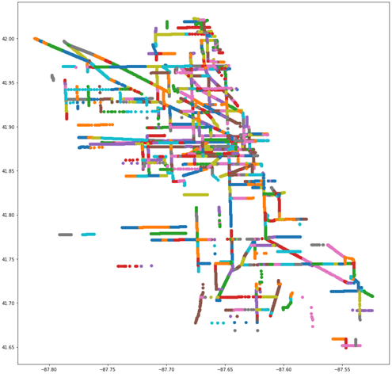
Data Set - Chicago Bike Lane Data
Retrieved from City of Chicago Data Portal
884 entries of bike path section
Data Attributes:
the_geom: A representation of the section using an array of geo-coordinates;
Street :The street name of the path
pre_dir: A prefix direction of the given street;
F_street: The intersection where the specific bike path begins;
T_street: The intersection in which the specific bike path ends; and
Display Rou: contains the type of bike path the section falls under such as protected, shared, etc.
MI_CTRLINE: This value did not contain any descriptions and its relationship to the dataset was not provided

Slide 5
Models and Techniques
K-means Clustering and Frequency Analysis (Haiyi and Aquil)
Geo-coordinates of bike paths were group using K-means clustering
Comparison of results between using simplified geo coordinates and all geo coordinates for clustering
The elbow method was used to determine cluster amount
Frequency analysis was used to determination the different types of bike paths present in each cluster
Graph Traversal and Node analysis of Bike Paths (Karandeep)
Bike paths and stations are plotted in an undirected graph as nodes and edges.
Hierarchical Clustering and Decision Tree(Knn) Modularity.
Degree centrality; longest and shortest paths within the graph is analyzed

Slide 6
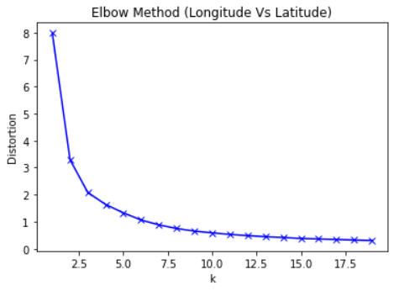
K-Means Clustering (One Node per Route)
Clustered using the ‘the_geom’ data field (Geo-coordinate representation of bike paths)
Simplified to one individual point per section
The Elbow Method was used to determine the appropriate number of clusters the data should be fitted on
Optimal number of clusters was 3

Slide 7
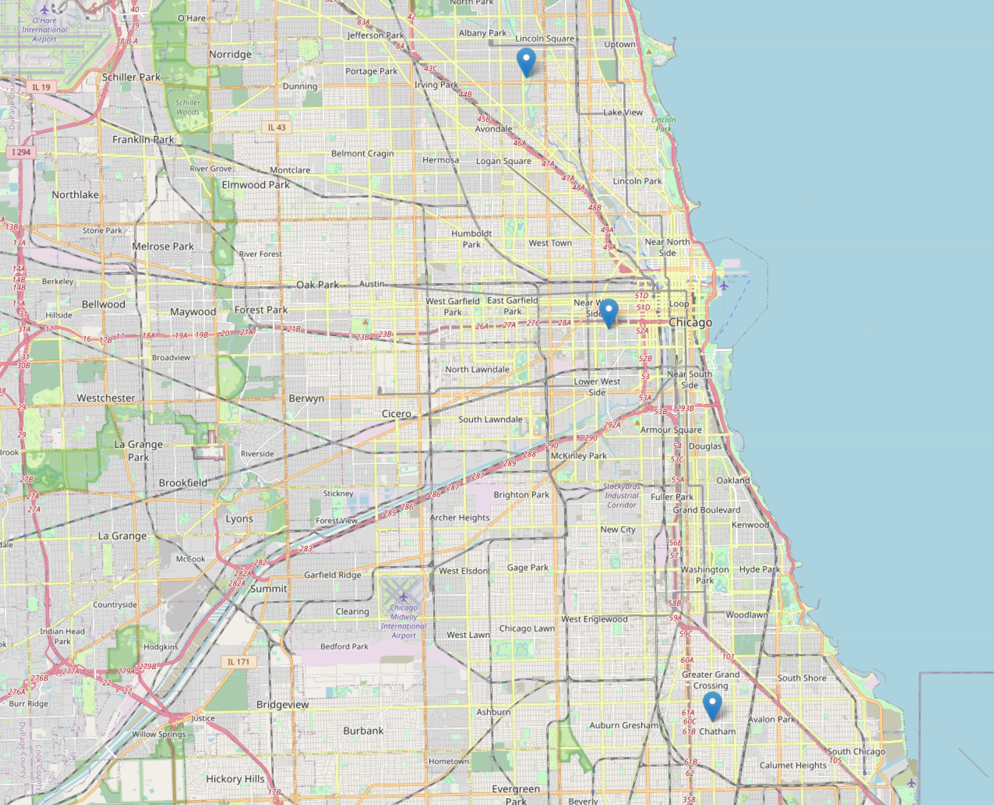
K-Means Results
Clustered into 3 different groups
Cluster centers of each group can be seen on the map
Cluster Center Locations:
0 (Downtown, City Center) : (41.87277229 , -87.66057474)
1 (Uptown, Northern Cluster) : (41.95522707 , -87.69695233)
2 (Southern Cluster): (41.74395235 , -87.61503366)
Recommendation of closest cycling areas can be given to riders based on the distance between their current geolocation and cluster centers

Slide 8
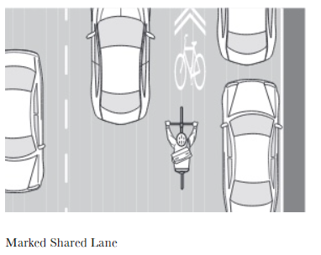
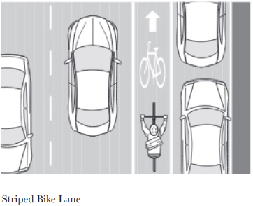
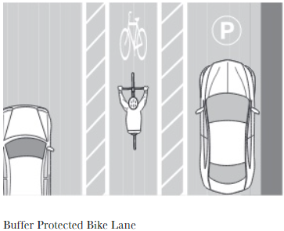
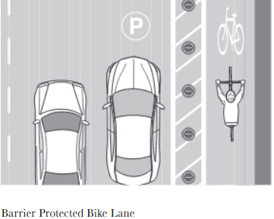
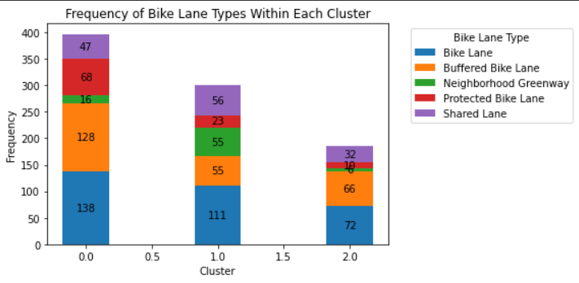
Frequency Analysis of Bike Lane
Five types of bike lanes were present offering different levels of safety:
Neighborhood Greenway (Safest)
Protected Bike Lane (2nd Safest)
Buffered Bike Lane (3rd)
Bike Lane (4^{th)}
Shared-Lane (Least safe)
Images retrieved from https://www.chicagobikeblog.com/blog/2019/7/1/bike-lane-basics
Frequencies of each type are then analyzed in each cluster to determine which cluster is safer to ride in
Higher ratios of safer bike lane types can generalize to safer areas to ride

Slide 9
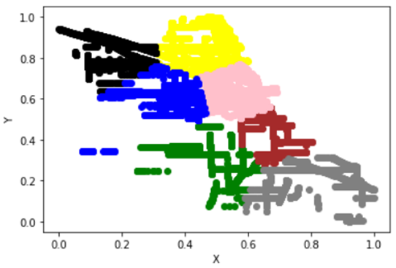
K-Means Clustering (All nodes)
Clustered using the ‘the_geom’ data field (Geo-coordinate representation of bike paths)
Used every node as a data point for the clustering
More overlapping data
Number of clusters = 7

Slide 10
Frequency Analysis
For each cluster, the bike lane type that occurs the most is highlighted.
The frequency of the bike lane type is also highlighted
This acts as an informative tool to allow the user to know what bike lane types they are most likely to come across around their respective area
CLUSTER | COLOUR | Bike lane type | COUNT
1 | GREEN | BIKE LANE | 93
2 | YELLOW | BUFFERED BIKE LANE | 39
3 | BROWN | BUFFERED BIKE LANE | 25
4 | BLACK | BIKE LANE | 65
5 | GREY | BUFFERED BIKE LANE | 24
6 | PINK | BIKE LANE | 27
7 | BLUE | BUFFERED BIKE LANE | 13

Slide 11
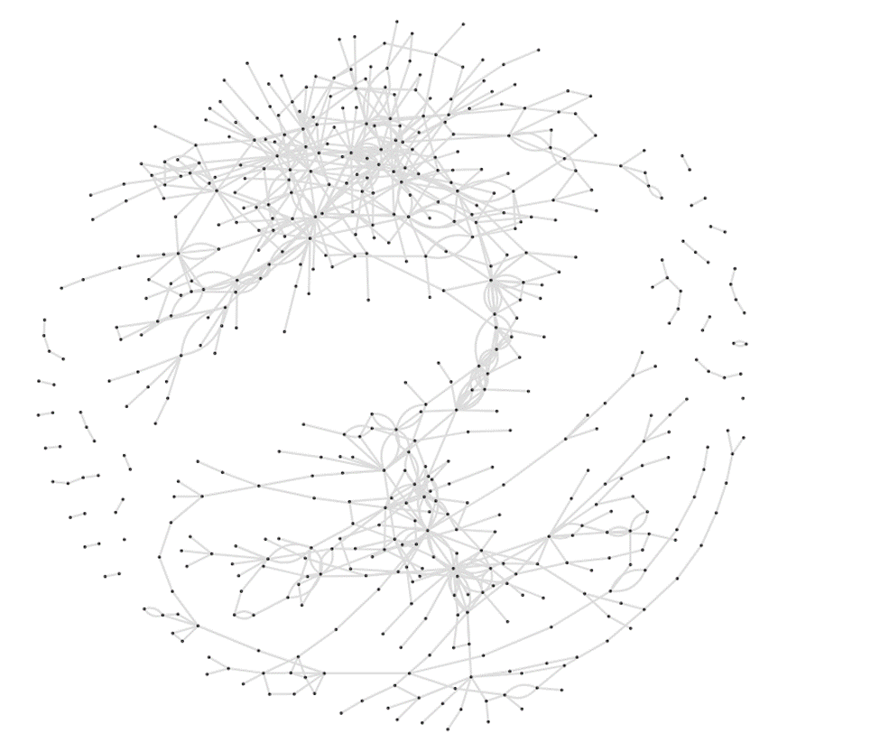
@SecondModel- Graph Traversal and Node Analysis
The datasets provided is decoded to python-igraph library and plotted as a undirected graph with bike-station as vertices and routes as edges. {G =(V,E)}

Slide 12
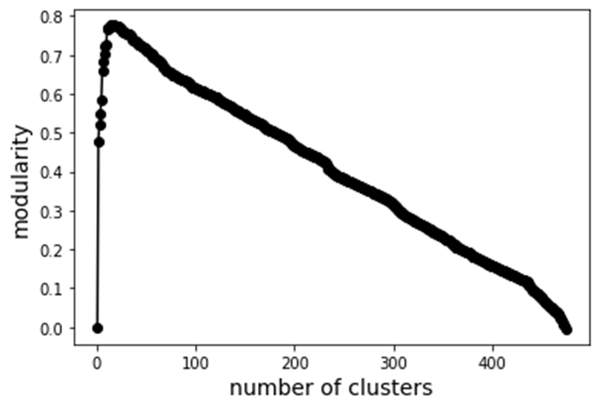
Hierarchy Clustering and Modularity
Validating the results with previous k-means clustering.
A subgraph is plotted that belongs to strong connected neighbours i.e max. modularity.
Computing the degree distribution of all connected nodes.
Computing degrees, we find the min and max degree vertex.
Maximum degree: 28 Vertex ID with the maximum degree: 152
Minimum degree: 1 Vertex ID with the minimum degree: 6
Maximum Modularity with clusters N = Range( 3 to 7)

Slide 13
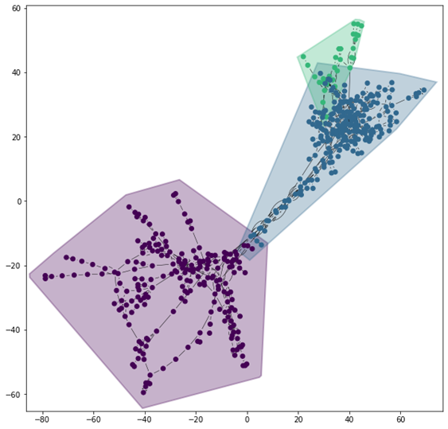
Community formation and groups
From hierarchy clustering method, also validated by k-means, minimum clusters with least overlapping found to be: (N=3)
Range varies from (3 -> 7)
3-> least overlapping
7-> maximum overlapping

Slide 14
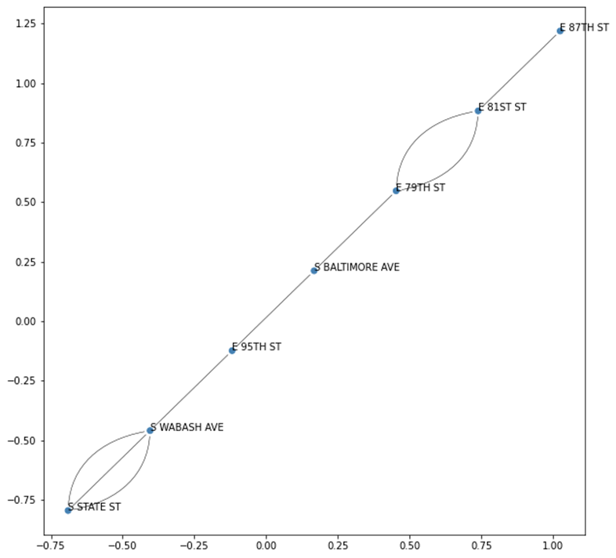
Degree Centrality and Shortest Walk b/w clusters
Distance from
Max->Degree node -> Cluster(0)
To
Min -> Degree Node -> Cluster(2)
Maximum walk of 6 length from the centroid node in densely cluster to sparse cluster in the graph.

Slide 15
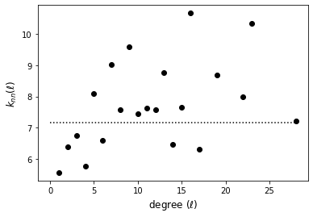
Justification of Hierarchy Model
Build a tree with a set of hierarchical decisions which eventually give a final result, i.e a classification/regression prediction.
Decision Tree models are created using two steps: Induction and pruning.
Decision Tree and Knn(l) Classification provides us best cluster model for grouping.

Slide 16
Lessons Learned
Clustering of bike routes in a given study area
Understanding modularity maximization in disconnected graphs.
Shortest walk through each community
Limitations
DATA MATTERS!
Future Research
Multi-objective research- More parameters
Optimizing Cyclist-pedestrian path sharing.

Slide 17

Questions

Slide 18
Thanks

